Slide 1
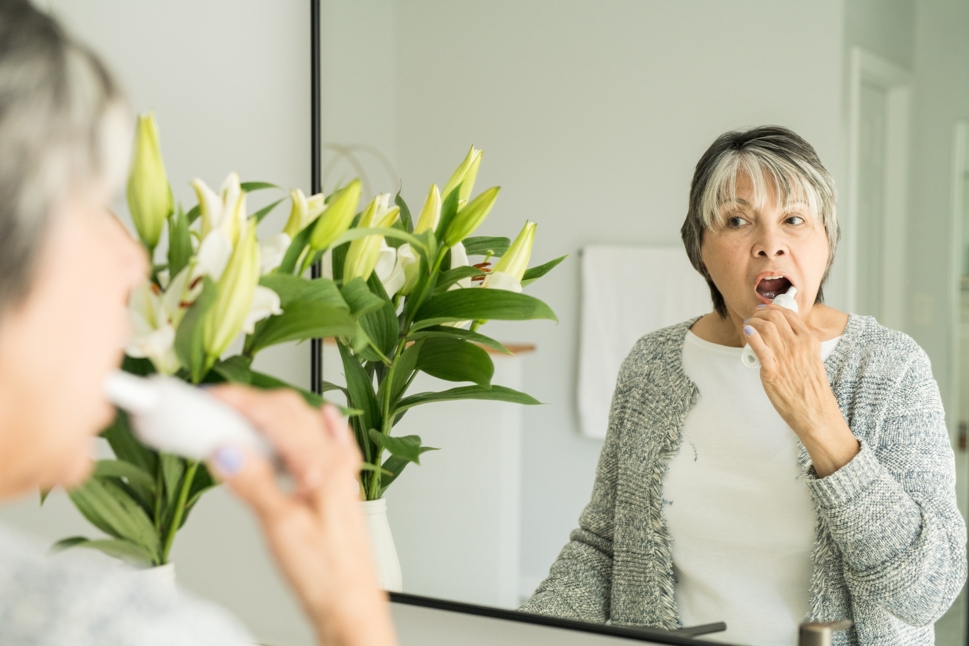
IFDH Elderly Patient Practices Survey
April 2022

Slide 2
Survey Background
Survey #6 in a series supported by Procter & Gamble conducted in April 2022. Objectives: To better understand global dental hygienists’ practices regarding elderly patients (> 65 years old). To identify opportunities for future educational programs. Survey flow: IFDH → 34 national associations → individual members.

Slide 3
558 respondents from 28 countries
Top countries
UK 19% Switzerland 16% Italy 15% Finland 7% Canada 6%
Korea 6% Ireland 5%
Portugal 5%
South Africa 4%
Spain 3% Czech Republic 3%
Countries with < 2% : USA, Netherlands, Belgium, Australia, Israel, Latvia, Sweden, Lithuania, Japan, Austria, Denmark, Germany, India, Malta, New Zealand, Slovak Republic, United Arab Emirates

Slide 4
Frequency of treating elderly patients
74% see elderly patients daily
Those respondents who see elderly patients at least once a month (517/558) continued with the survey questions.
How often do you see elderly patients (65 years or older)?
N=558

Slide 5
Among your elderly patients, how many present with the following diseases/conditions?
Diseases and conditions
Top 5 affecting ‘virtually all + most’ elderly patients - Gingival recession (88%) - Gingivitis (56%) - Erosive tooth wear (50%) - Periodontitis (49%) - Poor plaque control (43%)
N=517

Slide 6
Among your elderly patients, how many have the following types of dentures or implant restorations?
VIRTUALLY ALL means 80% - 100% MOST means 60% - 80%SOME mean 40% - 60% FEW means 20% - 40% VIRTUALLY NONE means 0% - 20%
Denture and implant restorations
Top 3 seen in ‘virtually all + most’ elderly patients: - Crowns (68%) - Removable partial denture (28%) - Single implant (20%)
N=517

Slide 7
How often do you recommend denture adhesive to your patients with removable complete or partial dentures?
Denture adhesive recommendations
14% ‘always’ or ‘often’ recommend 49% ‘rarely’ or ‘never’ recommend
N=378; respondents who see patients with removable dentures were asked this question

Slide 8
For which reasons do you recommend denture adhesive? (check all that apply)
Top reasons for recommending denture adhesive: 1) Stronger hold 2) Improve denture fit 3) Improve comfort
Provide a seal to prevent food penetration
N=334; respondents who recommend denture adhesive were asked this question

Slide 9
Please indicate how much you agree or disagree with the following statements:
> 60% agree or strongly agree
< 17% agree or strongly agree
N=517

Slide 10
How often do you recommend the following products to your elderly patients?
N=517

Slide 11
How would you rate your knowledge level on the following topics specifically related to elderly patients and the aging dentition?
Highest rated
Lowest rated
N=517

Slide 12
How likely are you to recommend an oral hygiene product that has been specifically designed for the needs of elderly patients (e.g., a toothbrush with a handle adapted for improved manual dexterity)?
64% are ‘extremely or very likely’ to recommend a product specifically designed for needs of elderly patients
N=517

Slide 13
Long-Term Care Facility Activities for Elderly Patients
Do you provide oral health care to elderly patients in a long-term care facility?
If you do not deliver care in a long-term care facility, would you be interested if the opportunity was provided?
Does your country’s regulatory body allow dental hygienists to work independently in long-term care or private homes?
N=517
N=517
N=394

Slide 14
Long-Term Care Facility Activities for Elderly Patients (continued)
Do you have the opportunity to instruct staff/residents in alternative oral care delivery to compensate for reduction of motor skills due to arthritis, Parkinson’s, etc.?
Would you be willing to be involved in a “teach the teacher” program where dental hygienists teach the care givers in long term care and they in turn teach each other?
Are you involved in teaching long-term care staff in oral care?
N=517, all questions

Slide 15
Demographics Years of dental hygiene experience Skewed slightly towards 25 years of experience or more
N=558

Slide 16
Work Setting 63% are in a private practice setting. 12% are in independent dental hygiene practices.
N=558

Slide 17
Education 63% have Bachelor’s Degree or Diploma
N=558

Slide 18
Other IFDH Survey Results
Click the links below to learn more about other IFDH surveys:
2022 Pediatric Patient Survey
2021 Oral-systemic link survey
2021 Electric toothbrush survey
2020 Covid Survey
2019 Toothpaste Survey
The IFDH thanks Procter & Gamble for supporting these surveys.

