Slide 1
IFDH Toothpaste Knowledge and Recommendation Habits Survey
January 2020

Slide 2
Background
Series of 3 surveys implemented by IFDH, supported by Procter & Gamble.
Purpose:
To explore global dental hygienists’ knowledge and recommendation habits regarding 1) Fluoride dentifrices, Fall ‘19 2) Electric toothbrushes, Spring ‘20 3) Pediatric care, Fall ‘20
To identify common information sources and knowledge gaps to guide future educational programs
Survey flow: IFDH → 31 member countries → members (English)

Slide 3
Respondents
480 respondents from 20 countries
Top 5 = 76%
Korea 26%
Switzerland 16%
Canada 16%
Ireland 10%
South Africa 8%
Countries with 5% to 1%
Netherlands, UK, Latvia, Denmark, Sweden, India
Countries with <1%
USA, Japan, Australia, Czech Republic, Austria, Finland, Germany, Lithuania, Portugal
Notes:
South Africa 7.71% Netherlands 5.42% United Kingdom 4.17% Latvia 3.75% Denmark 3.12% Sweden 2.5% India 1.46% United States of America 0.83% Japan 0.62% Australia 0.42% Czech Republic 0.42% Austria 0.21% Finland 0.21% Germany 0.21% Lithuania 0.21% Portugal 0.21%

Slide 4
Years working as DH, OHT or DT
Notes:
Good representation across all groups in terms of years in practice

Slide 5
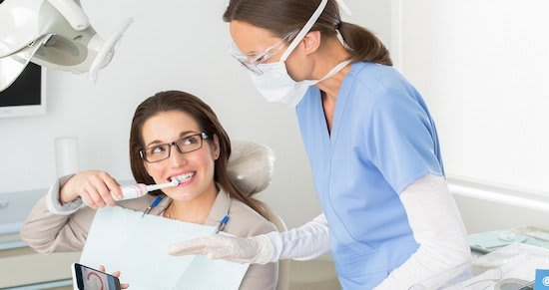
Primary Practice Setting

Slide 6
Highest Degree Earned
Notes:
Options were supposed to be changed…for some reason they did not.

Slide 7
Importance of factors in making product recommendations
Factor (ext + very impt %)
Patient disease risk (93%)
Evidence in literature (84%)
CE programs (81%)
Post-clinical experience (87%)
Info learned in school (69%)
Patient preference (67%)
Discussions w/colleagues (66%)
Product samples (61%)
Prof journal ads (45%)

Slide 8
Importance of factors in making product recommendations (cont.)
Factor (ext + very impt %)
Personal preference (52%)
Office policy
Endorsement by KOL
Mfg sales rep
Ads on TV

Slide 9
Recommend specific non-Rx fluoride toothpaste?

Slide 10
Fluoride recommended most often
N=288
Notes:
Good representation across all groups in terms of years in practice

Slide 11
Resources used at least once a month to assist in making decisions about toothpaste recommendations

Slide 12
Of those using manufacturer sales rep info to help make recommendation decisions, which manufacturer?
N=75

Slide 13
Agree or disagree with statements?
Statement (strongly/somewhat agree%)
Toothpaste provides benefits beyond brushing alone. (84%)
Choosing the right toothpaste is just as important as choosing the right toothbrush. (80%)
The toothpaste patients choose plays an important role in their oral health. (79%)
I wish I had received more information about tooth-paste ingredients in dental hygiene school. (61%)
The effectiveness of stannous fluoride toothpastes can vary based on how they are formulated. (64%)
All fluorides provide similar benefits. (58%)

Slide 14
Initial Observations
Good representation across age groups, practice settings. Need to compare all demographic characteristics versus averages.
Opportunity to provide education on differences among fluorides.
40% not making a specific non-prescription fluoride toothpaste recommendation, despite ~80% agreeing that toothpaste plays important role in oral health and choosing right toothpaste is just as important as choosing the right toothbrush.
58% agree that all fluorides provide similar benefits and NaF is recommended more than 2x more than SnF₂; however, SnF₂ actually offers many more clinically-proven benefits that other fluorides don’t: gingival health, sensitivity, erosion, breath.
Top resources for making toothpaste recommendations: Samples Publications/magazines Manufacturer materials/sales reps
Most important factors in making product recommendations (in general): Patient disease risk Evidence in literature Post-clinical experience CE programs Info learned in school Discussions w/colleagues Patient preference Product samples

