Slide 1
IFDH Electric Toothbrush Knowledge and Recommendation Habits Survey
January 2021

Slide 2
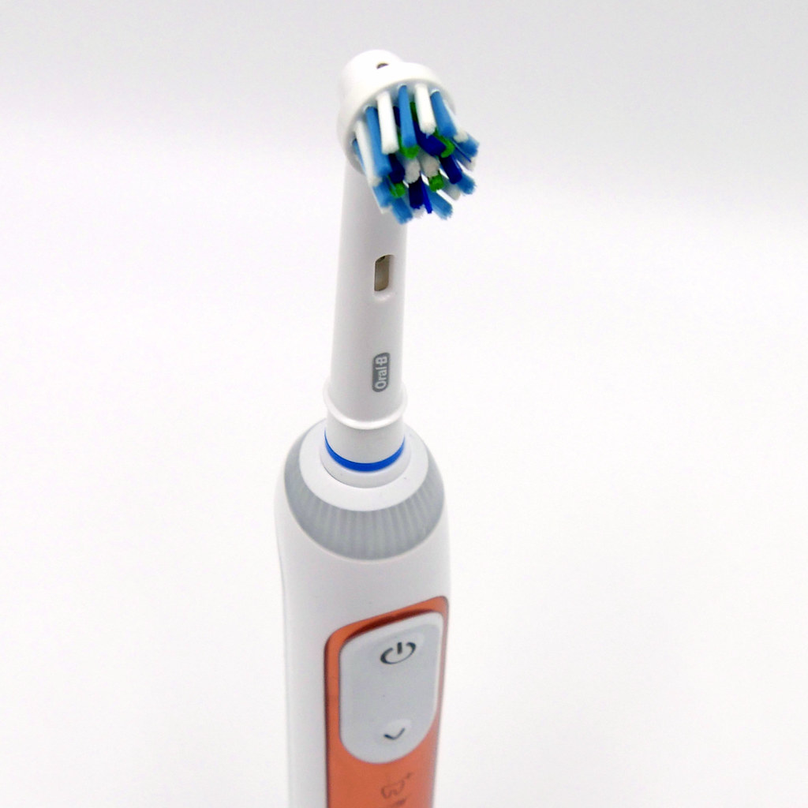
Electric toothbrush survey background
Final of 3-survey series supported by Procter & Gamble Objective: To explore global dental hygienists’ knowledge and recommendation habits regarding electric toothbrushes Information used to guide future educational programs Survey flow: IFDH → 31 member countries → members

Slide 3
4,345 respondents from 36 countries
Top 4 countries
United States of America 72%
Korea 5%
Italy 4%
Switzerland 3%
Countries with 1-2% Israel, South Africa, Finland, New Zealand, Canada, Norway, Latvia, Australia, Portugal, Netherlands, Sweden, India, Malta
Countries with < 1%: Spain, Ireland, Denmark, Russia, United Kingdom, Japan, Austria, Germany, Norway, Armenia, Bhutan, Colombia, Czech Republic, Liechtenstein, Lithuania, Nigeria, Philippines, Swaziland, United Arab Emirates

Slide 4
Years of experience Balanced representation across categories

Slide 5
Work Setting Majority in private practice, general dentistry

Slide 6
Education 76% have a 2- or 4-year degree

Slide 7
96% recommend electric toothbrushes
Do you recommend electric toothbrushes?

Slide 8
Among those who don’t recommend, top 3 reasons are: 1. believe manual brushes (MT) are just as effective 2. believe MT are gentler on soft tissues 3. need more information
Why don’t you recommend electric toothbrushes?
MT=manual toothbrushes; ET= electric toothbrushes

Slide 9
Most popular electric brush type recommended: -Sonic -Oscillating-rotating
Which type of electric toothbrush do you recommend most?

Slide 10
Electric brushes recommended for most patient types, except young children
To which type of patients do you recommend electric toothbrushes? (Check all that apply)
All patients | 58%
Adults with consistent plaque build-up | 48%
Adults with gingival health issues | 45%
Patients with limited dexterity | 45%
Perio maintenance patients | 43%
Orthodontic patients | 39%
Elderly | 38%
Adolescents (10-18 years) | 33%
Caretakers | 30%
Implant patients | 27%
Children (6-9 years) | 19%
Young children (3-5 years) | 7%
Other | 2%

Slide 11
Few respondents would recommend against using an electric brush. Most common patients not to receive recommend are post-surgical and young children.
To which type of patients would you NOT recommend electric toothbrushes? (Check all that apply)
None, an electric toothbrush would be appropriate for all patients | 50%
Post-surgical patients | 27%
Young children (age 3-5 years) | 23%
Aggressive brushers | 8%
Patients with erosive tooth wear | 8%
Patients with dentinal hypersensitivity | 7%
Adults with gingival recession | 5%
Children (age 6-9 years) | 5%
Other | 4%
Orthodontic patients | 3%
Implant patients | 2%
Adolescents (age 10-18 years) | 2%

Slide 12
Common resources to make electric brush recommendation: - Personal usage - Peer feedback - Publications
Which resources do you use to assist you in making clinical decisions for recommending ELECTRIC TOOTHBRUSHES to your patients? (check all that apply)
My personal usage experience | 83%
Feedback from my colleagues/peers | 52%
Peer-reviewed journals (e.g., Int J Dent Hyg) | 52%
Professional magazines (e.g., RDH, Access) | 45%
Manufacturer’s professional sales rep information | 35%
Online patient education/instructional videos by industry | 25%
Pamphlets supplied by manufacturers | 22%
Manufacturer’s product website | 20%
Educational posters | 11%
Textbooks | 10%
Social media websites (e.g., Facebook groups) | 10%
Other | 4%

Slide 13
Most popular sales rep resources are from: 1. Oral-B 2. Sonicare
N=1474

Slide 14
Most common information patients seek about electric toothbrushes: 1. Comparison vs manual toothbrushes 2. Comparison vs other electric models 3. Cost
What type of information do patients request regarding electric toothbrushes? (Check all that apply)
How an electric toothbrush compares to a manual toothbrush | 72%
The cost of the electric toothbrush | 72%
Differences between types of electric toothbrushes | 69%
How often to replace the brush head | 59%
The cost of the electric toothbrush heads | 47%
Electric toothbrushing instructions | 45%
How an electric toothbrush works | 40%
Tell-show-do method | 38%
If an electric toothbrush is safe to use | 36%
If the electric toothbrush handle can be shared with other family members | 31%
How to clean an electric toothbrush | 17%
How to use the App with the electric toothbrush | 8%
None; my patients don't request information regarding electric toothbrushes. | 2%
Other | 1%

Slide 15
45% say more than half of patients act on recommendation to purchase an electric brush
As best as you can say, what percentage of your patients purchase an electric toothbrush after you recommend it?

Slide 16
Most respondents agree: - electric brushes (ET) provide better cleaning and gingival health benefits vs. manual - pressure sensor is valuable to control force - ET are safe, helpful to patients of all ages
Statement | Strongly agree
There is strong evidence that ET remove more plaque than MT. | 66%
I prefer patients use an ET with a pressure sensor so they brush with the right amount of force. | 65%
ET are beneficial for patients of all ages, from young children to elderly. | 59%
My patients who use ET have noticeably better gingival health. | 57%
There is strong evidence that ET reduce gingival bleeding more than MT. | 54%
There is strong evidence that ET transition more patients to gingival health than MT. | 54%
ET are just as gentle and safe as manual toothbrushes. | 53%
There are differences in plaque removal effectiveness among the various types of ET. | 39%
Smart toothbrushes with an App to track brushing time and behavior are valuable to help patients develop better brushing habits. | 19%
MT=manual toothbrushes; ET= electric toothbrushes

Slide 17
Other IFDH Survey Results
Click the links below to learn more about other IFDH surveys in this series:
2020 Covid Survey
2019 Toothpaste Survey
The IFDH thanks Procter & Gamble for supporting these surveys.

